Slide 1


Monte Carlo estimation of pi
Final project by Jacob Mulligan

Slide 2
The Problem and it’s importance
The goal of this project is to demonstrate that a rough estimation of the value pi can be determined from the ratio of points that land in the area of a circle and square when the circle is inside the square.
Aside from estimating pi Monte Carlo simulations have a very practical purpose in business and statistics.
Monte Carlo estimation of pi is a singular example of the importance of these kind of simulations.
The purpose of these simulations is to create a probability distribution to aid in math mathematical proof or decision making and the more data the simulation has the closer the estimate can be to the expected outcomes.
My project does not differ from the research that already exist.
The proofs basis is if we know that the area of the square is 1 unit while the cirle is pi * (1/2)² = pi/4.
From this the simulation can be made from: (area of circle)/(area of square) = (points in circle)/(total points in square).
That is to say pi = 4 * (num points in circle / num points in square)

Slide 3
Probability and The simulation
If you generate a 2-D point uniformly at random within the unit square, then the probability that the point is inside the circle is equal to the ratio of the area of the circle divided by the area of the unit square. That is, P(point inside circle) = Area(quarter circle) / Area(unit square) = π/4. It is easy to use a Monte Carlo simulation to estimate the probability P: generate N random points inside the unit square and count the proportion that fall in the quarter circle.
So using this probability distribution as a function that operates over a sequence of random draws, I am able to build my simulation of the estimation of π.
In my simulation I also preform other statistical analysis to future show the accuracy in my estimation

Slide 4
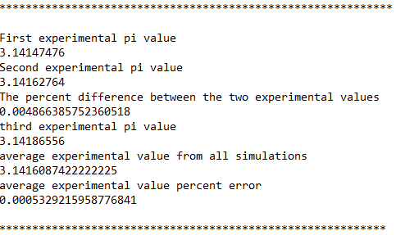
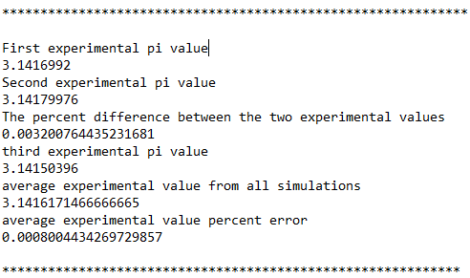
Simulation
Using a distribution of multiple simulations I am able to find a more accurate estimation of π.
I calculate percent difference to understand variance in my method.
Then from the average of the estimates I calculate the percent error to test how accurate my simulation is to the expected value 3.141592.

Slide 5
Next Steps
From now until the due date I hope to build up my narrative for my final report. Providing more in-depth research of the importance and purpose of Monte Carlo simulations.
Create formal proofs of topics discussed in the final report.
Brush up on my LaTex

